Slide 1
Your briefing: Because You Matter Conversations

Slide 2
What are the Because you Matter Conversations all about?
The Because you Matter Conversations are an opportunity for all staff and volunteers at Mid Cheshire Hospitals NHS Foundation Trust to discuss our behaviours for now and the future in an anonymous, safe space.
Together, we have built strong foundations for our Trust, and we know that our staff and volunteers have played a vital part in this. Now it is time to build upon these foundations and shape a culture and environment that we all want for our future.

Slide 3
How does it work?
The second Conversation will be open online for from 16-30 January. You are invited to:
Check and challenge the draft behaviours that we expect from one another to uphold our values
Tell us about the opportunities we have to improve patient care and staff experience in our future plans, including our digital clinical system and our new hospital programme

Slide 4
What happens with what is said?
Our independent partner, Clever Together, will analyse every contribution and produce a second report about what you said.
We will then use this to:
Agree our behaviours and embed them into our ways of working
Inform our plans for our future together

Slide 5
Why are we doing this?
We believe that every voice needs to be heard, and that you hold the answers to many of the challenges we face. We want to give you the opportunity to share your views.
The Because you Matter Conversations are an opportunity to share in a safe environment with the promise that your contributions will be heard, recognised and actioned.
By working together to agree the behaviours that uphold our values and sharing your ideas for our future together, we can all have a voice in creating our culture and better tomorrow.

Slide 6
How do I get involved?
Staff: You will receive an email invitation with your login details when the Conversation launches on 16 January
Volunteers and Lead Employer Trainee Junior Doctors: Register now at becauseyoumatter.clevertogether.com/en/sign-up

Slide 7
Our ask of you
Spread the word using the Communications Toolkit Encourage your colleagues to participate - everyone is invited Make sure your people are heard - ask if they've got involved and if they know why it’s important to join the Conversation Get involved and tell people why the Conversations are different - this is an interactive, immediately insightful and dynamic Conversation

Slide 8
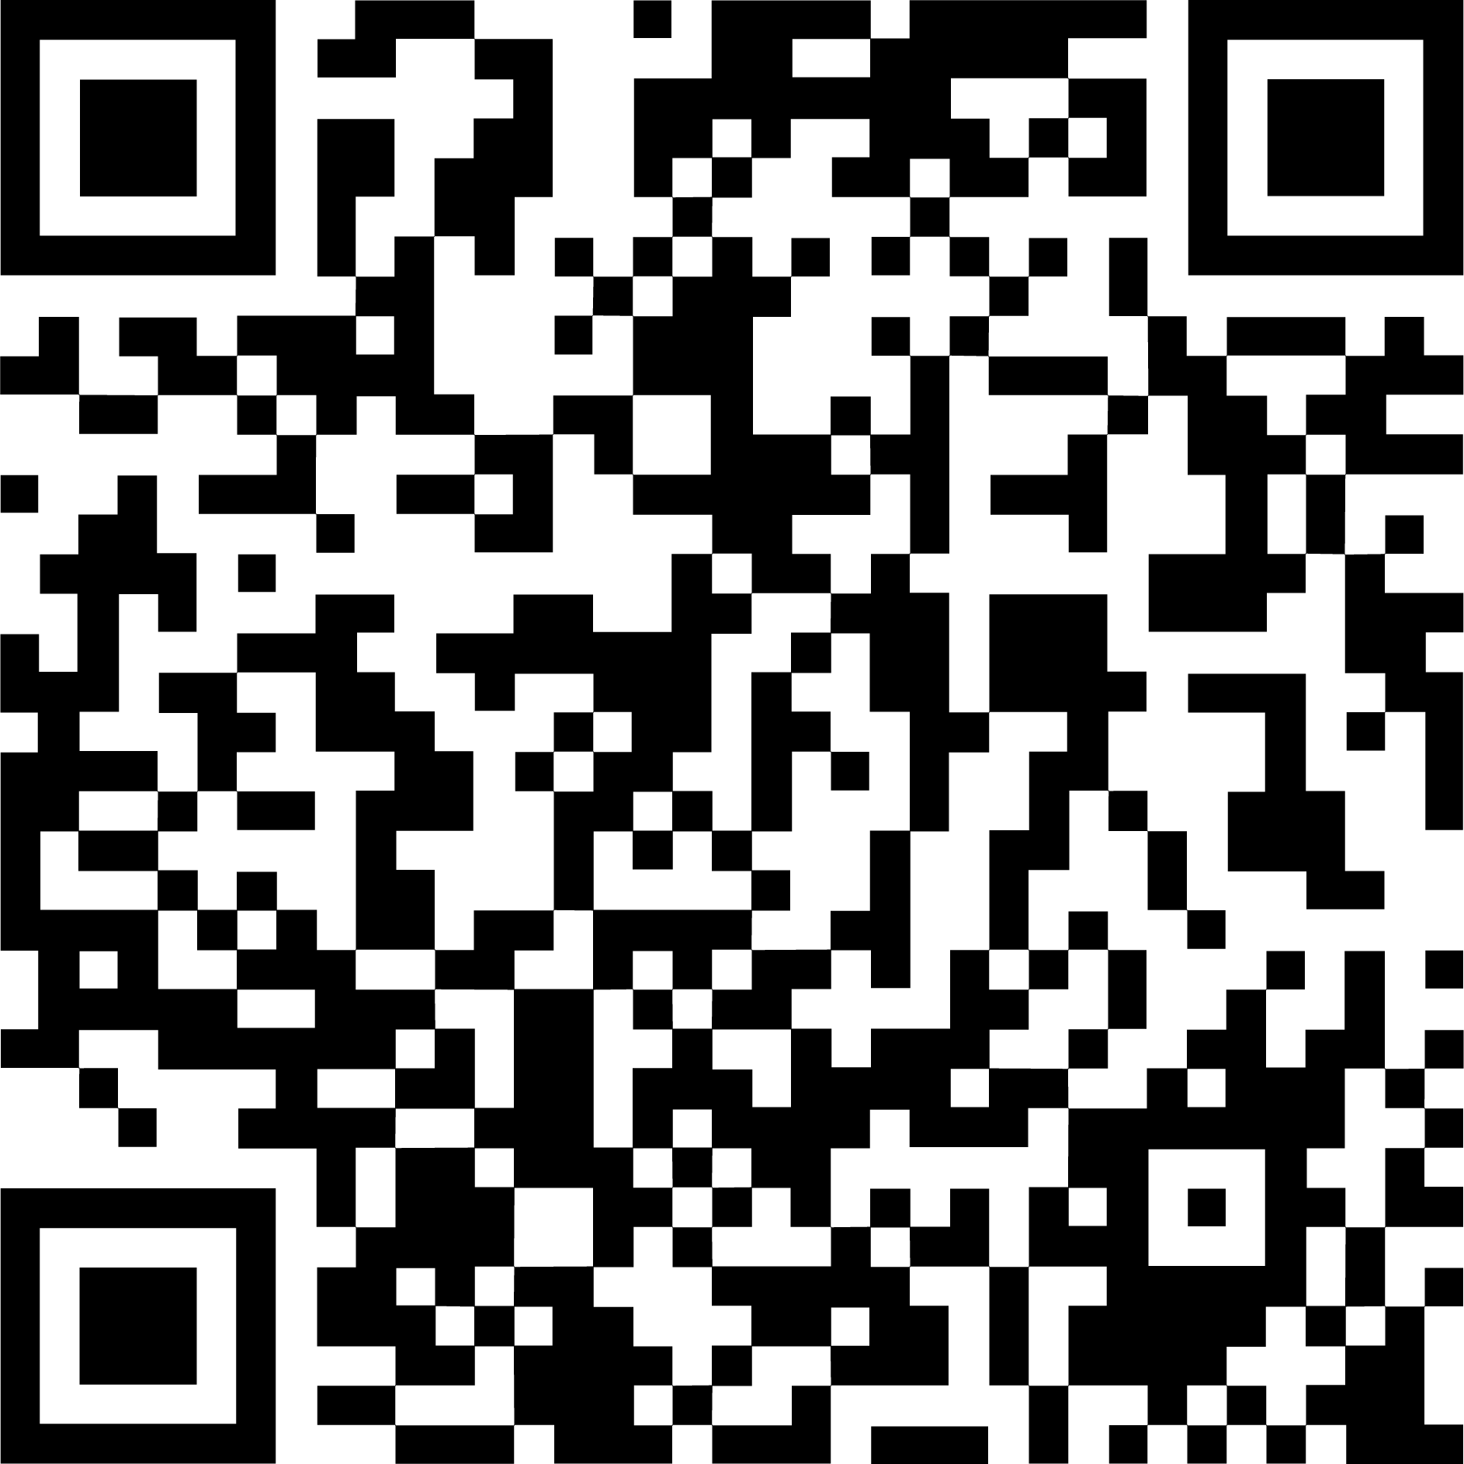
becauseyoumatter.clevertogether.com

